Slide 1


Tree: Design pattern example and AVL tree

Slide 2
Recall the categories of pattern
Creational design patterns
These design patterns are all about class instantiation. This pattern can be further divided into class-creation patterns and object- creational patterns.
Structural design patterns
These design patterns are all about Class and Object composition. Structural class-creation patterns use inheritance to compose interfaces.
Behavioural design patterns
These design patterns are all about Class's objects communication. Behavioural patterns are those patterns that are most specifically concerned with communication between objects.

Slide 3
The Visitor Pattern
The Visitor Pattern falls under the category of behavioral design patterns
Intent
Represent an operation to be performed on the elements of an object structure. Visitor lets you define a new operation without changing the classes of the elements on which it operates.
The classic technique for recovering lost type information.
Do the right thing based on the type of two objects.
Double Dispatch is used to invoke an overloaded method where the parameters vary among an inheritance hierarchy

Slide 4
The Visitor Pattern
Collaborations:
A client that uses the Visitor pattern must create a ConcreteVisitor object and then traverse the object structure, visiting each element with the visitor.
When an element is visited, it calls the Visitor operation that corresponds to its class. The element supplies itself as an argument to this operation to let the visitor access its state, if necessary.

Slide 5
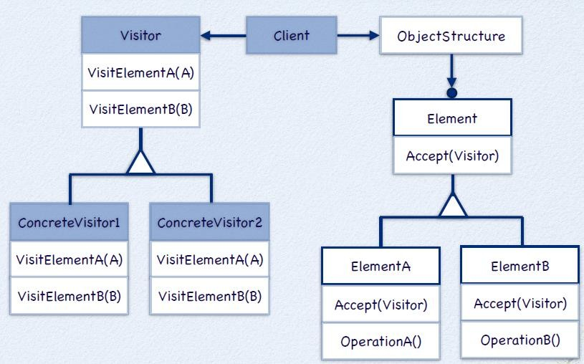
Structure of Visitor

Slide 6
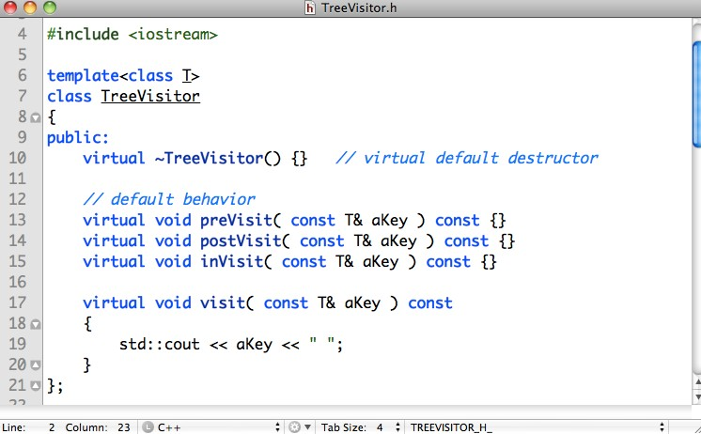
A Tree Visitor
Pre-Order, Post-Order In-Order
from DFS

Slide 7
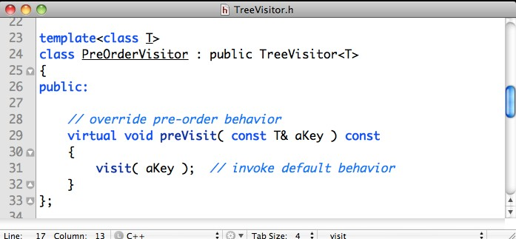
PreOrderVisitor

Slide 8
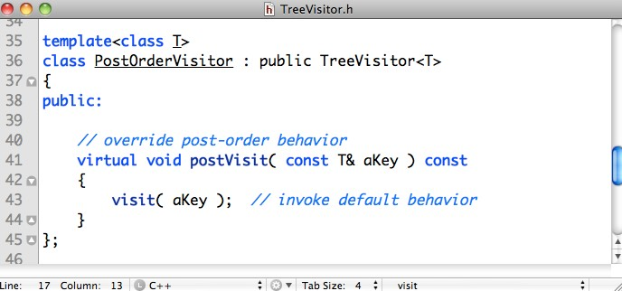
PostOrderVisitor

Slide 9
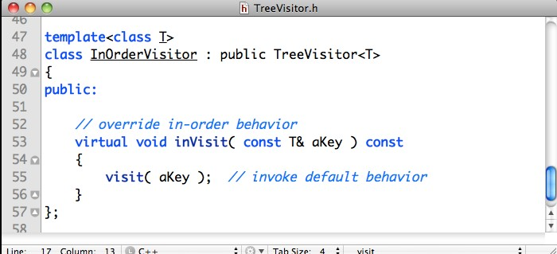
InOrderVisitor

Slide 10
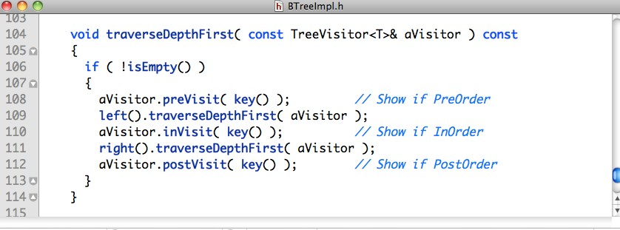
Depth-first Traversal for BTree

Slide 11
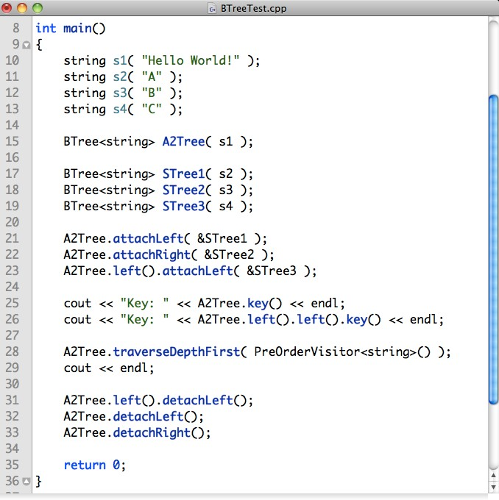
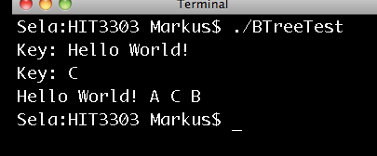

Slide 12
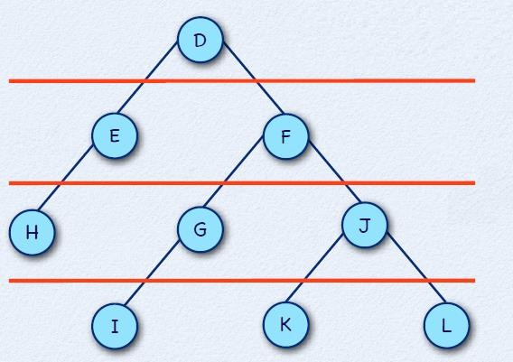
Breadth-first Traversal Implementation
Traversal : D-E-F-H-G-J-I-K-L

Slide 13
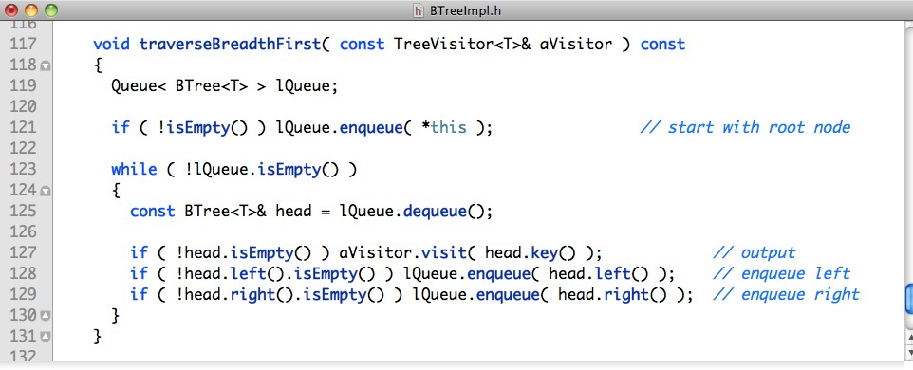
Breadth-first Traversal for BTree

Slide 14
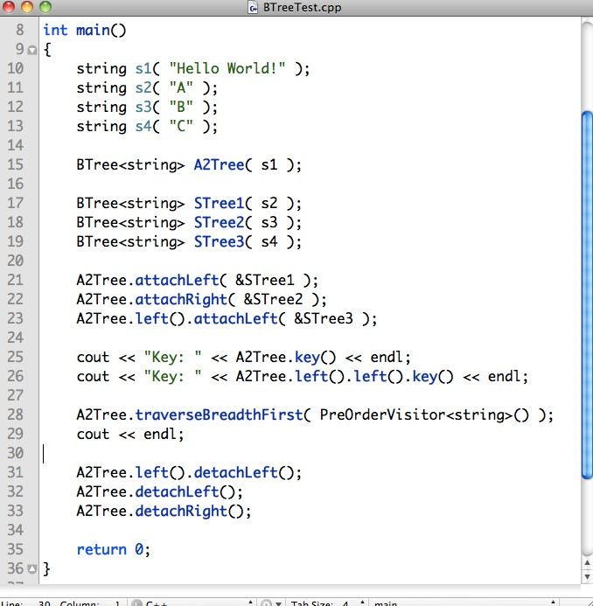
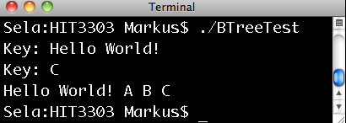

Slide 15

Visitor Design Pattern (Java)
URL: https://www.youtube.com/watch?v=pL4mOUDi54o

Slide 16
AVL Tree
Named after 2 Russian mathematicians
Georgii Adelson-Velsky (1922 - ?)
Evgenii Mikhailovich Landis (1921-1997)

Slide 17
AVL Tree
AVL trees are height-balanced binary search trees
A tree where no leaf is much farther away from the root than any other leaf.
1) Left subtree of Tree is balanced
Right subtree of Tree is balanced
The difference between heights of left subtree and right subtree is
not more than 1.
Balance factor of a node
height(left subtree) - height(right subtree)

Slide 18
AVL Tree
An AVL tree has balance factor calculated at every node
For every node, heights of left and right subtree can differ by no more than 1
Store current heights in each node

Slide 19
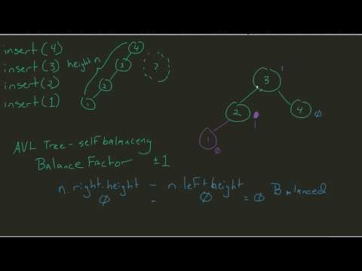
AVL Trees
URL: https://www.youtube.com/watch?v=IGd7yIcxL6U

Slide 20
Is this a AVL tree?
The height of the tree is 4, meaning the length of the longest path from the root to a leaf node.
A
B
C
The height of the left subtree of the root is 3, meaning that the length of the longest path from the node B to one of the leaf nodes (G, J K or I).
For finding the balancing factor of the root we subtract the height of the right subtree and the left subtree : 3-1 = 2.
The balancing factor of the node with the key I is very easy to determine. We notice that the node has no children so the balancing factor is 0
D
E
F
G
H
I
J
K
For finding the balancing factor of the node with key D we substract the height of the right subtree from the height of the left subtree: 0-1= -1.

Slide 21
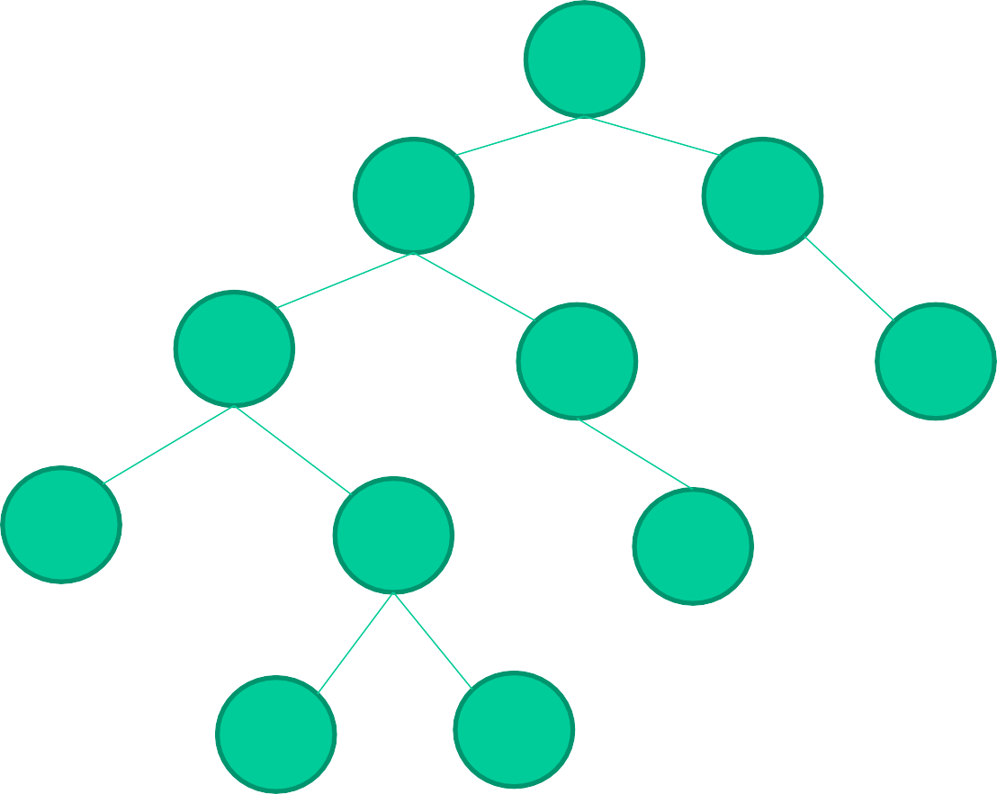
Balance factor
(2)
A
(1)
(-1)
B
C
(-1)
(0)
(-1)
D
E
F
(0)
(0)
(0)
G
H
I
(0)
(0)
J
K
The binary tree is balanced when all the
balancing factors of all the nodes are -1,0,+1.
This binary tree is not balanced at the Root.

Slide 22
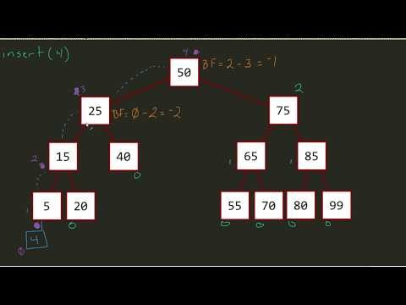
AVL Tree – Calculating Balance Factor
URL: https://www.youtube.com/watch?v=ke4DeoG1bUA

Slide 23
Insert and Rotation in AVL Trees
Insert operation may cause balance factor to become 2 or –2 for some node
only nodes on the path from insertion point to root node have possibly changed in height
So after the Insert, go back up to the root node by node, updating heights
If a new balance factor (the difference h_{left}-h_{right}) is 2 or –2, adjust tree by rotation around the node

Slide 24
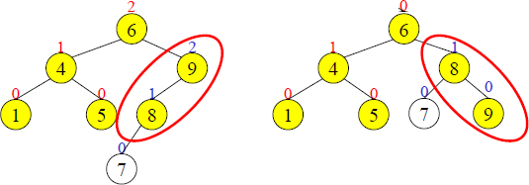
Single Rotation in an AVL Tree

Slide 25
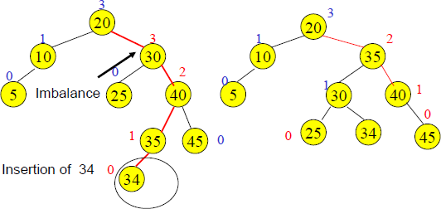
Double Rotation

Slide 26
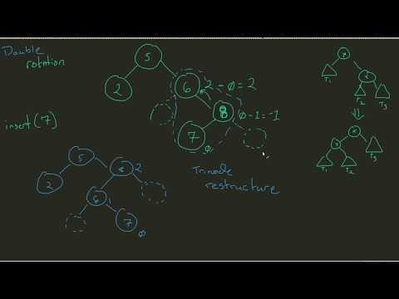
AVL Tree – Understanding Double Rotation
URL: https://www.youtube.com/watch?v=5m5fPidj6Mo

Slide 27
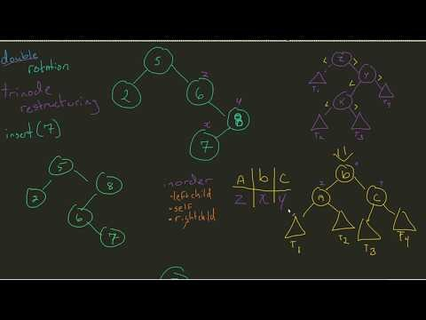
AVL Tree – Double Rotation
URL: https://www.youtube.com/watch?v=M_yhWNNCnGU

Slide 28
Insertions in AVL Trees
Let the node that needs rebalancing be α.
There are 4 cases:
Outside Cases (require single rotation) :
1. Insertion into left subtree of left child of α.
2. Insertion into right subtree of right child of α.
Inside Cases (require double rotation) :
3. Insertion into right subtree of left child of α.
4. Insertion into left subtree of right child of α.
The rebalancing is performed through four separate rotation algorithms, left-left rotation, right-right rotation, right-left rotation and left-right rotation.

Slide 29
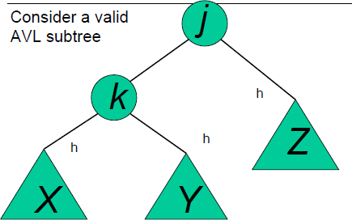
AVL Insertion: Outside Case

Slide 30
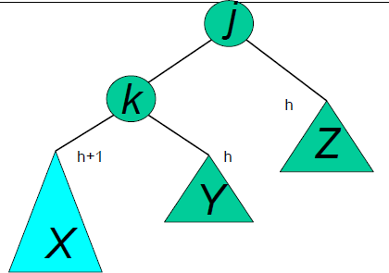
AVL Insertion: Outside Case
Inserting into X destroys the AVL property at node j

Slide 31
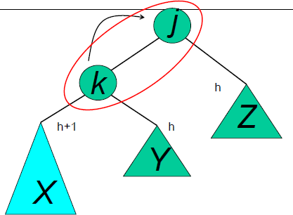
AVL Insertion: Outside Case
Do a “right rotation”

Slide 32
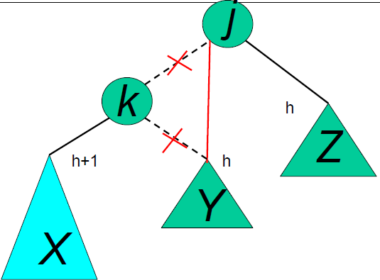
Single Right Rotation
Do a “right rotation”

Slide 33
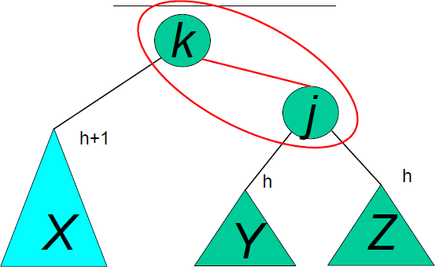
Outside Case Completed
“Right rotation” done! (“Left rotation” is mirror symmetric)
AVL property has been restored!

Slide 34
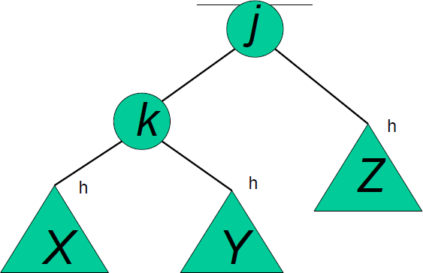
AVL Insertion: Inside Case
Consider a valid AVL subtree

Slide 35
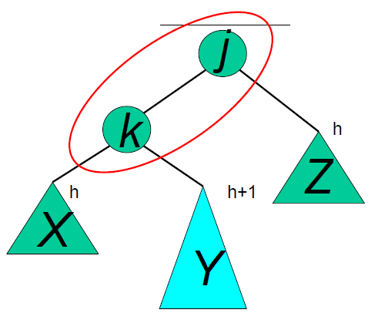
AVL Insertion: Inside Case
Inserting into Y destroys the AVL property at node j
Does “right rotation” restore balance?

Slide 36
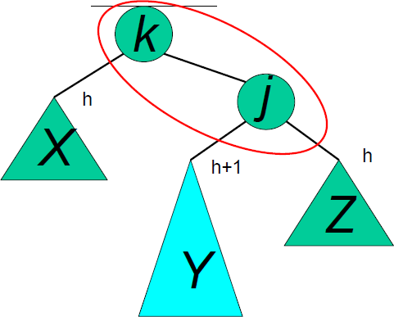
AVL Insertion: Inside Case
“Right rotation” does not restore balance… now k is out of balance

Slide 37
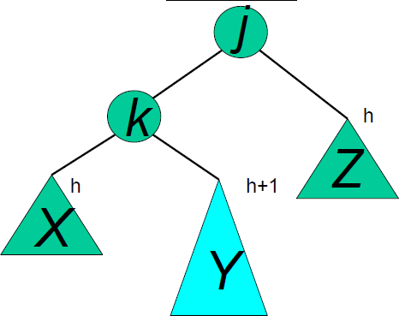
AVL Insertion: Inside Case
Consider the structure of subtree Y…

Slide 38
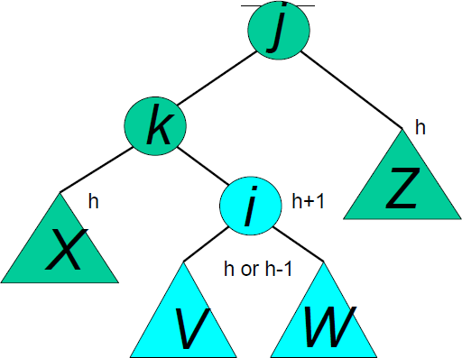
AVL Insertion: Inside Case
Y = node i and subtrees V and W

Slide 39
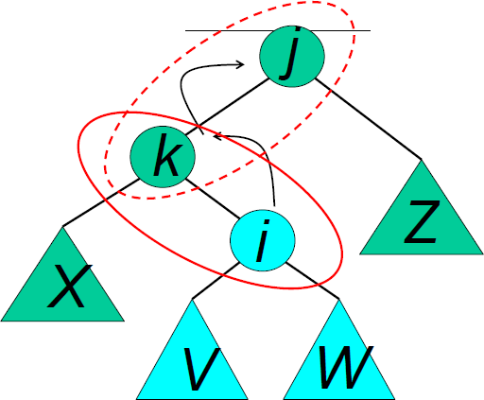
AVL Insertion: Inside Case
We will do a left-right “double rotation” . . .

Slide 40
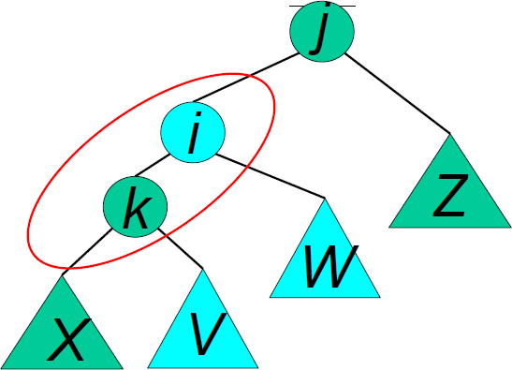
Double rotation : first rotation
left rotation complete

Slide 41
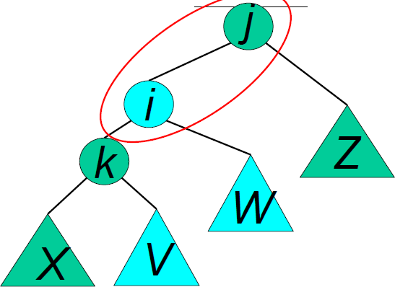
Double rotation : second rotation
Then do a right rotation

Slide 42
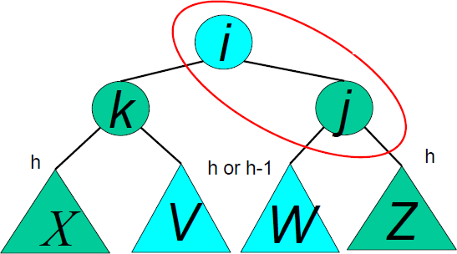
Double rotation : second rotation
right rotation complete: Balance has been restored

Slide 43
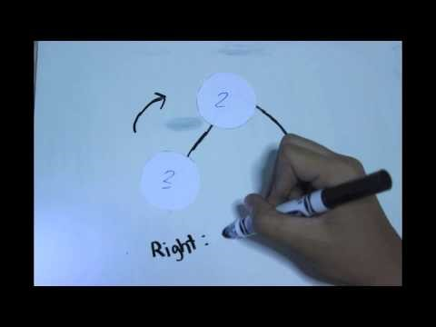
AVL Tree – Insertion and Rotation
Some mistakes in the video: At 7:36, It is a Left Rotation, not Right Rotation.
At 8:40, the 5 node was accidentally placed on the right side. It should be on the left.
URL: https://www.youtube.com/watch?v=C2wec04RcZg

Slide 44
End of Tree (Part 2) Design pattern example and AVL tree
You can check these links out for extra reading:
Binary Trees
http://math.hws.edu/eck/cs225/s03/binary_trees/
AVL Trees and Where to Rotate Them
https://medium.com/@sarahzhao25/avl-trees-where-to-find-rotate-them-7b062e0a30f8

